Slide 1

Department of Electrical Engineering
INDUSTRIAL TRAINING PRESENTATION ON
132KV/33KV GRID SUBSTATION DEEG, BHARATPUR
SUBMITTED By:
Vivek Faujdar
Roll No. 192094

Slide 2
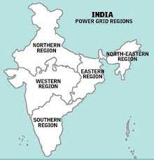
Introduction:
India is divided in 5 regions for power system planning and operation.
These regions are
Northern Region
Western Region
Eastern Region
Northeastern Region

Slide 3
Rajasthan Rajya Vidyut Prasaran Nigam Limited RVPN
RRVPNL is a company of Rajasthan State Electricity Board (RESB) established by government of Rajasthan.
132 GSS of Deeg (Bharatpur) is a part of RVPN.

Slide 4
SUBSTATION
A substation is a large installation of transformers to change voltage levels between high transmission voltages and lower distribution voltages or at the interaction of two different transmission voltages

Slide 5
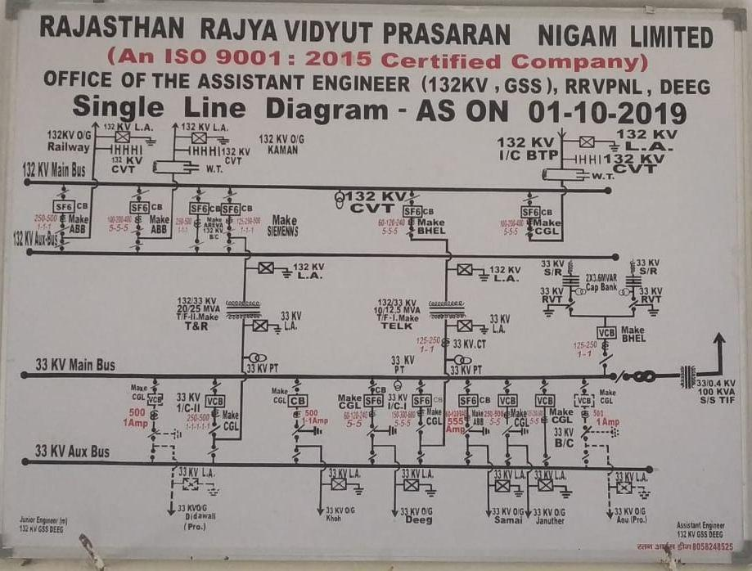
Single Line Diagram

Slide 6
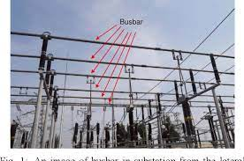
ELECTRIC BUS BAR
It is a type of electrical junction in which all the incoming and outgoing electrical current meets. Thus, the electrical bus bar collects the electric power at one location.
The copper and aluminium are used for the manufacturing of the electrical bus bar.
In Deeg Substation two type of busbars are used: Main busbar and Aux Bus bar

Slide 7
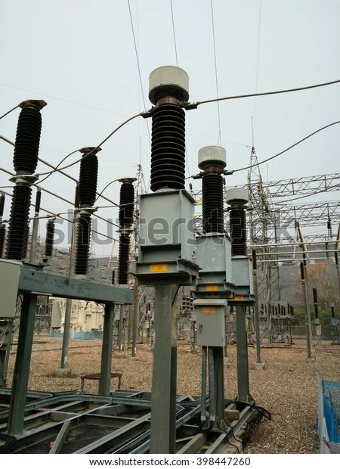
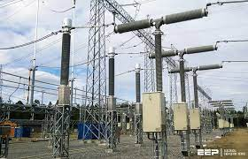
INSTRUMENT TRANSFORMER
Specially designed transformer which is used to measure high alternating current is called instrument transformer
Current Transformer: It is used to measure alternating current & protection in power system
Potential Transformer: Potential transformer is a voltage step down transformer which reduces the voltage of a suitable value

Slide 8
PROTECTION SCHEMES
Capital investment is involved in the power system so great that proper precaution must be taken to ensure that the equipments not only operate as nearly as possible to peak efficient but also it is protected from the accident.
Two main components of protection schemes:
Protective relay
Circuit breakers

Slide 9
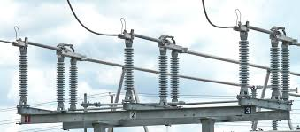
PROTECTIVE RELAYS AND CIRCUIT BREAKERS
When failure occurs at any part of the system it must be quickly detected and disconnected from the system
Rapid disconnection of the faulted apparatus limits the amount of damage to it and prevents the effect of fault from spreading into the system.
For high voltage circuit relays are employed to serve the desired function of automatic protective gear. The relays detect the fault and supply the information to the circuit breaker.

Slide 10
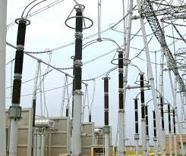
LIGHTNING ARRESTERS
Lightning arrester is protective device which provides protection against high voltage from lighting
Lightining arrester has two terminal viz a high voltage terminal and a ground terminal

Slide 11
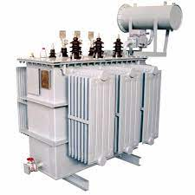
TRANSFORMER
The main device of the substation is transformer.
It is used to step-down the voltage and transfer power from one AC voltage to another AC voltage at the same frequency
Main Parts
Winding
Core
Tap Changer
Cooling fans
Buchholz relay

Slide 12
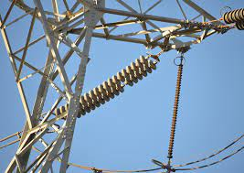
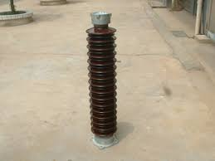
INSULATORS
In order to avoid current leakage to earth, through the supporting structure provided to the conductor of the overhead transmission line, insulators are used.

Slide 13
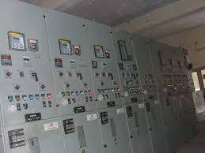
CONTROL ROOM
Increase reliability and performance of electrical protection
Remote switching and advanced supervisory control
Intelligent load shedding system

Slide 14
THANK YOU

